Slide 1
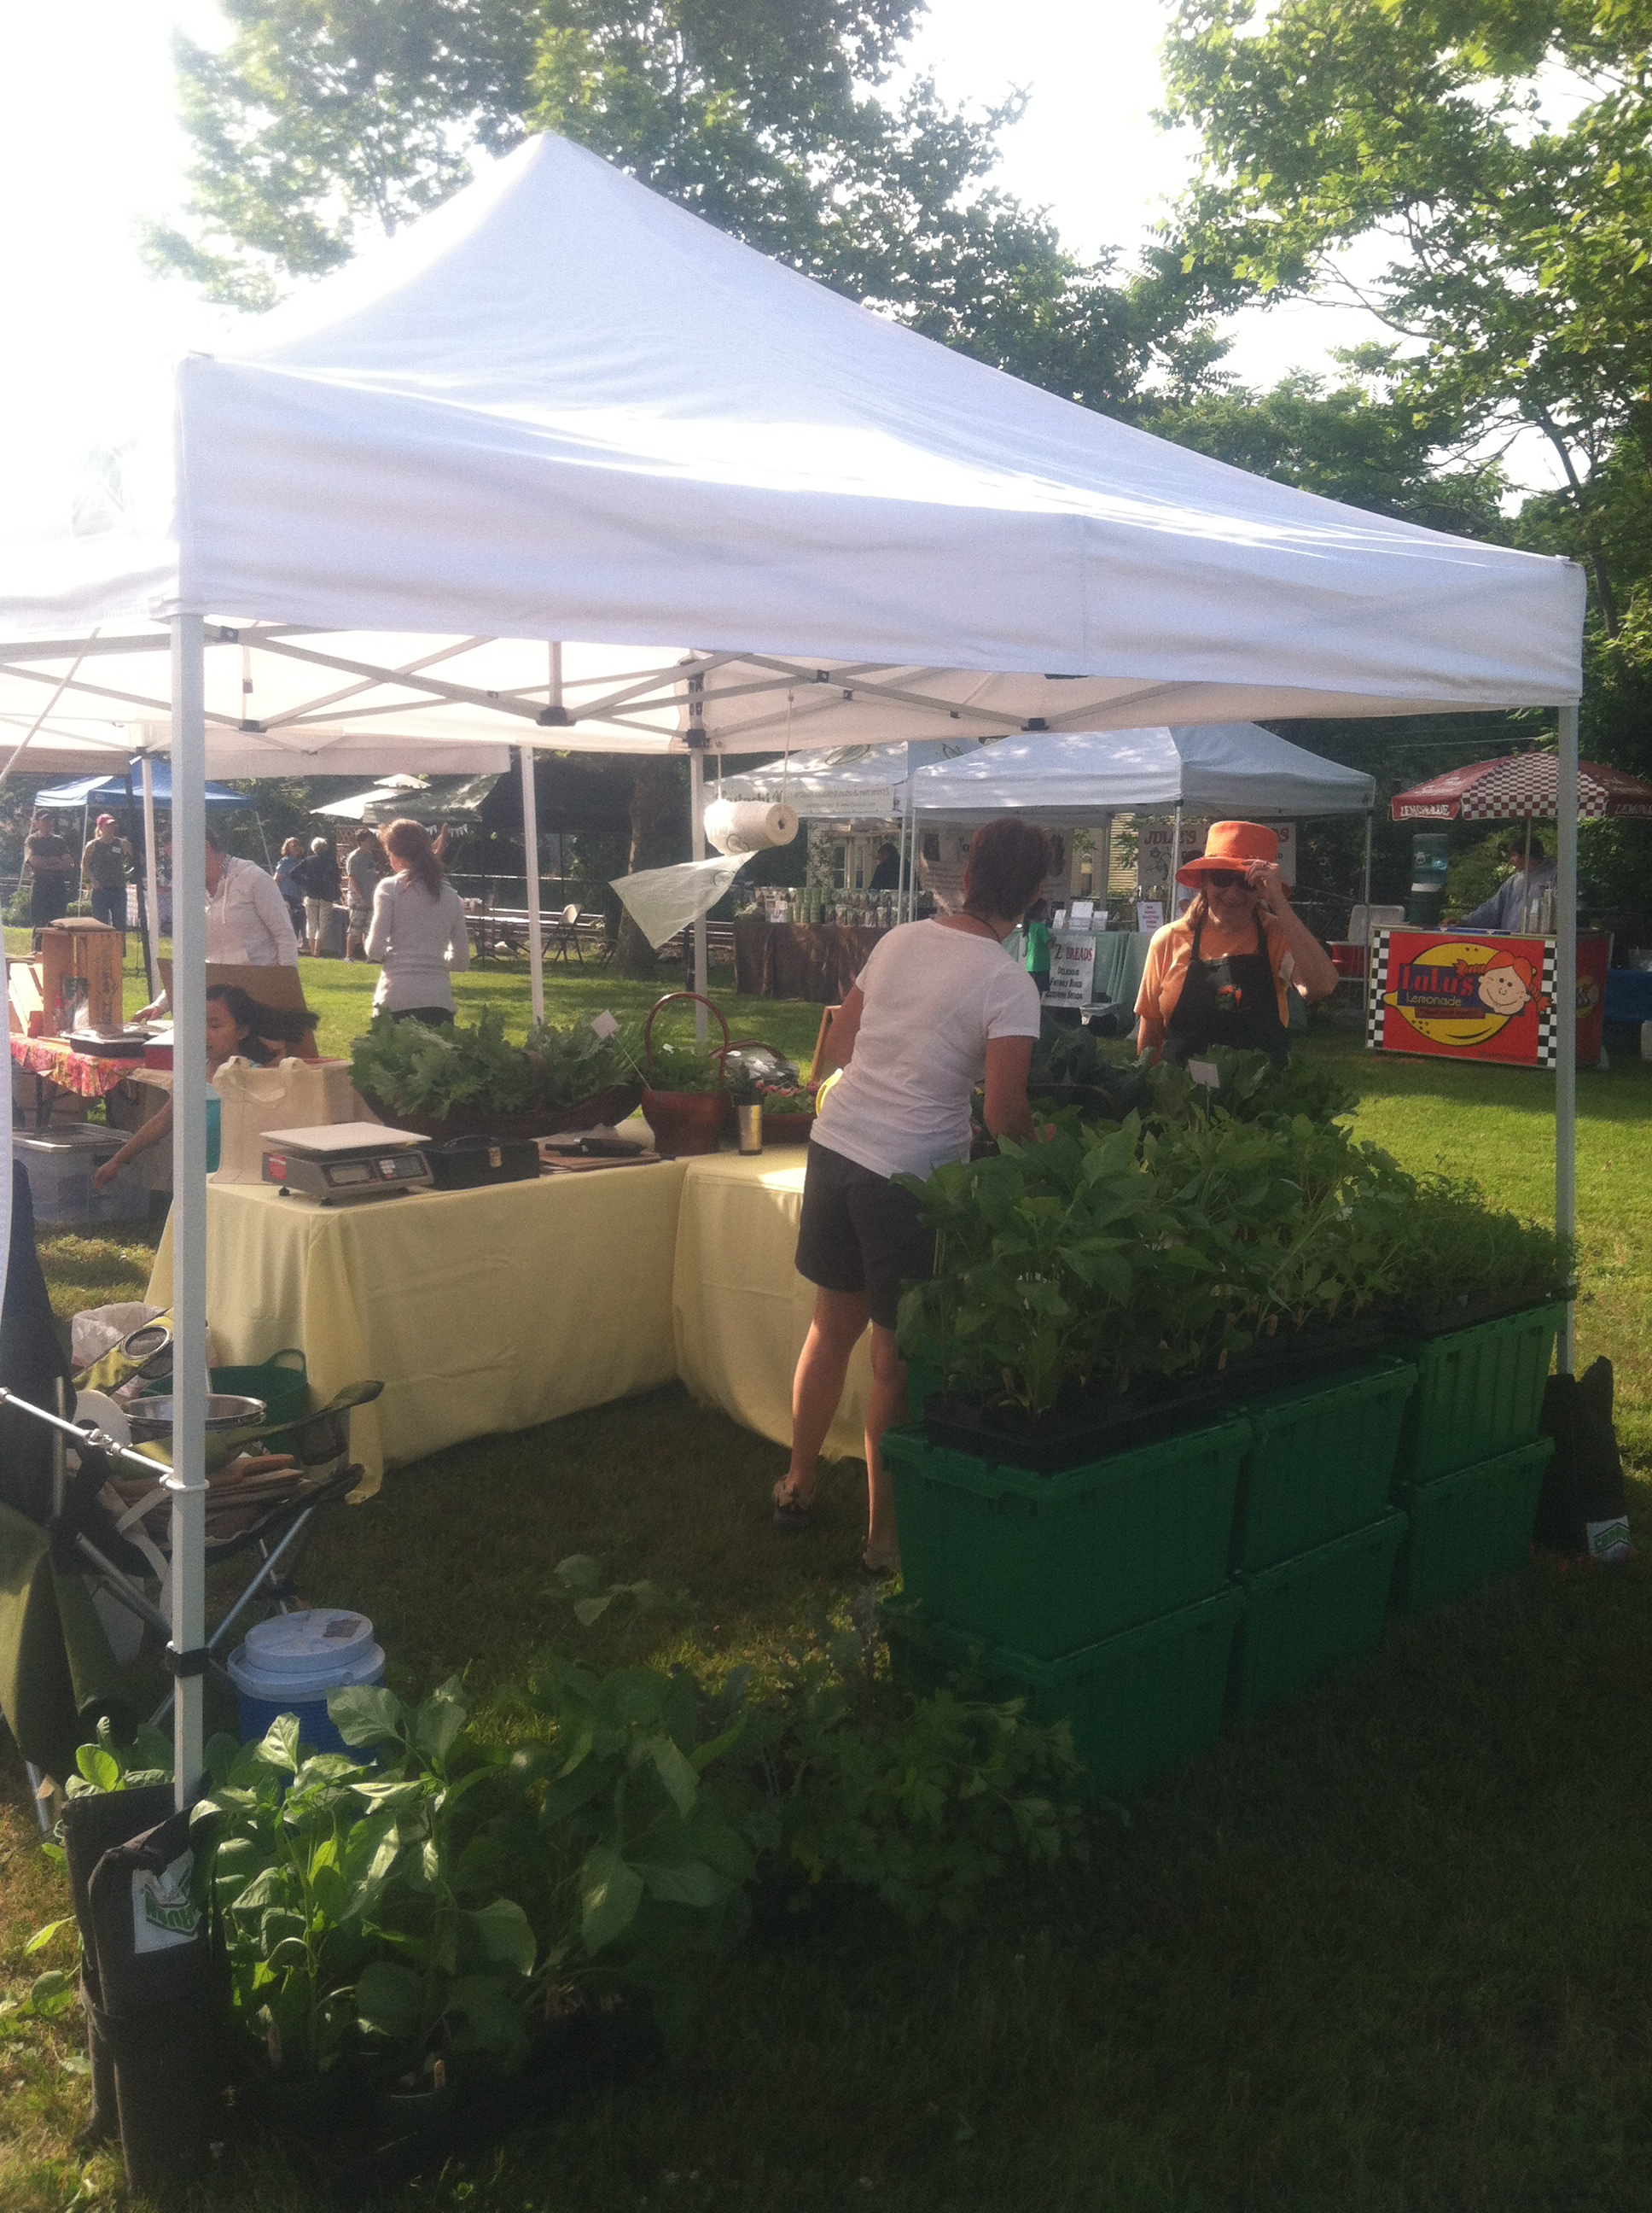
Hopkinton Farmers Market
Creating a revitalized farmers market and new venue through enhanced community involvement
January 8, 2013

Slide 2
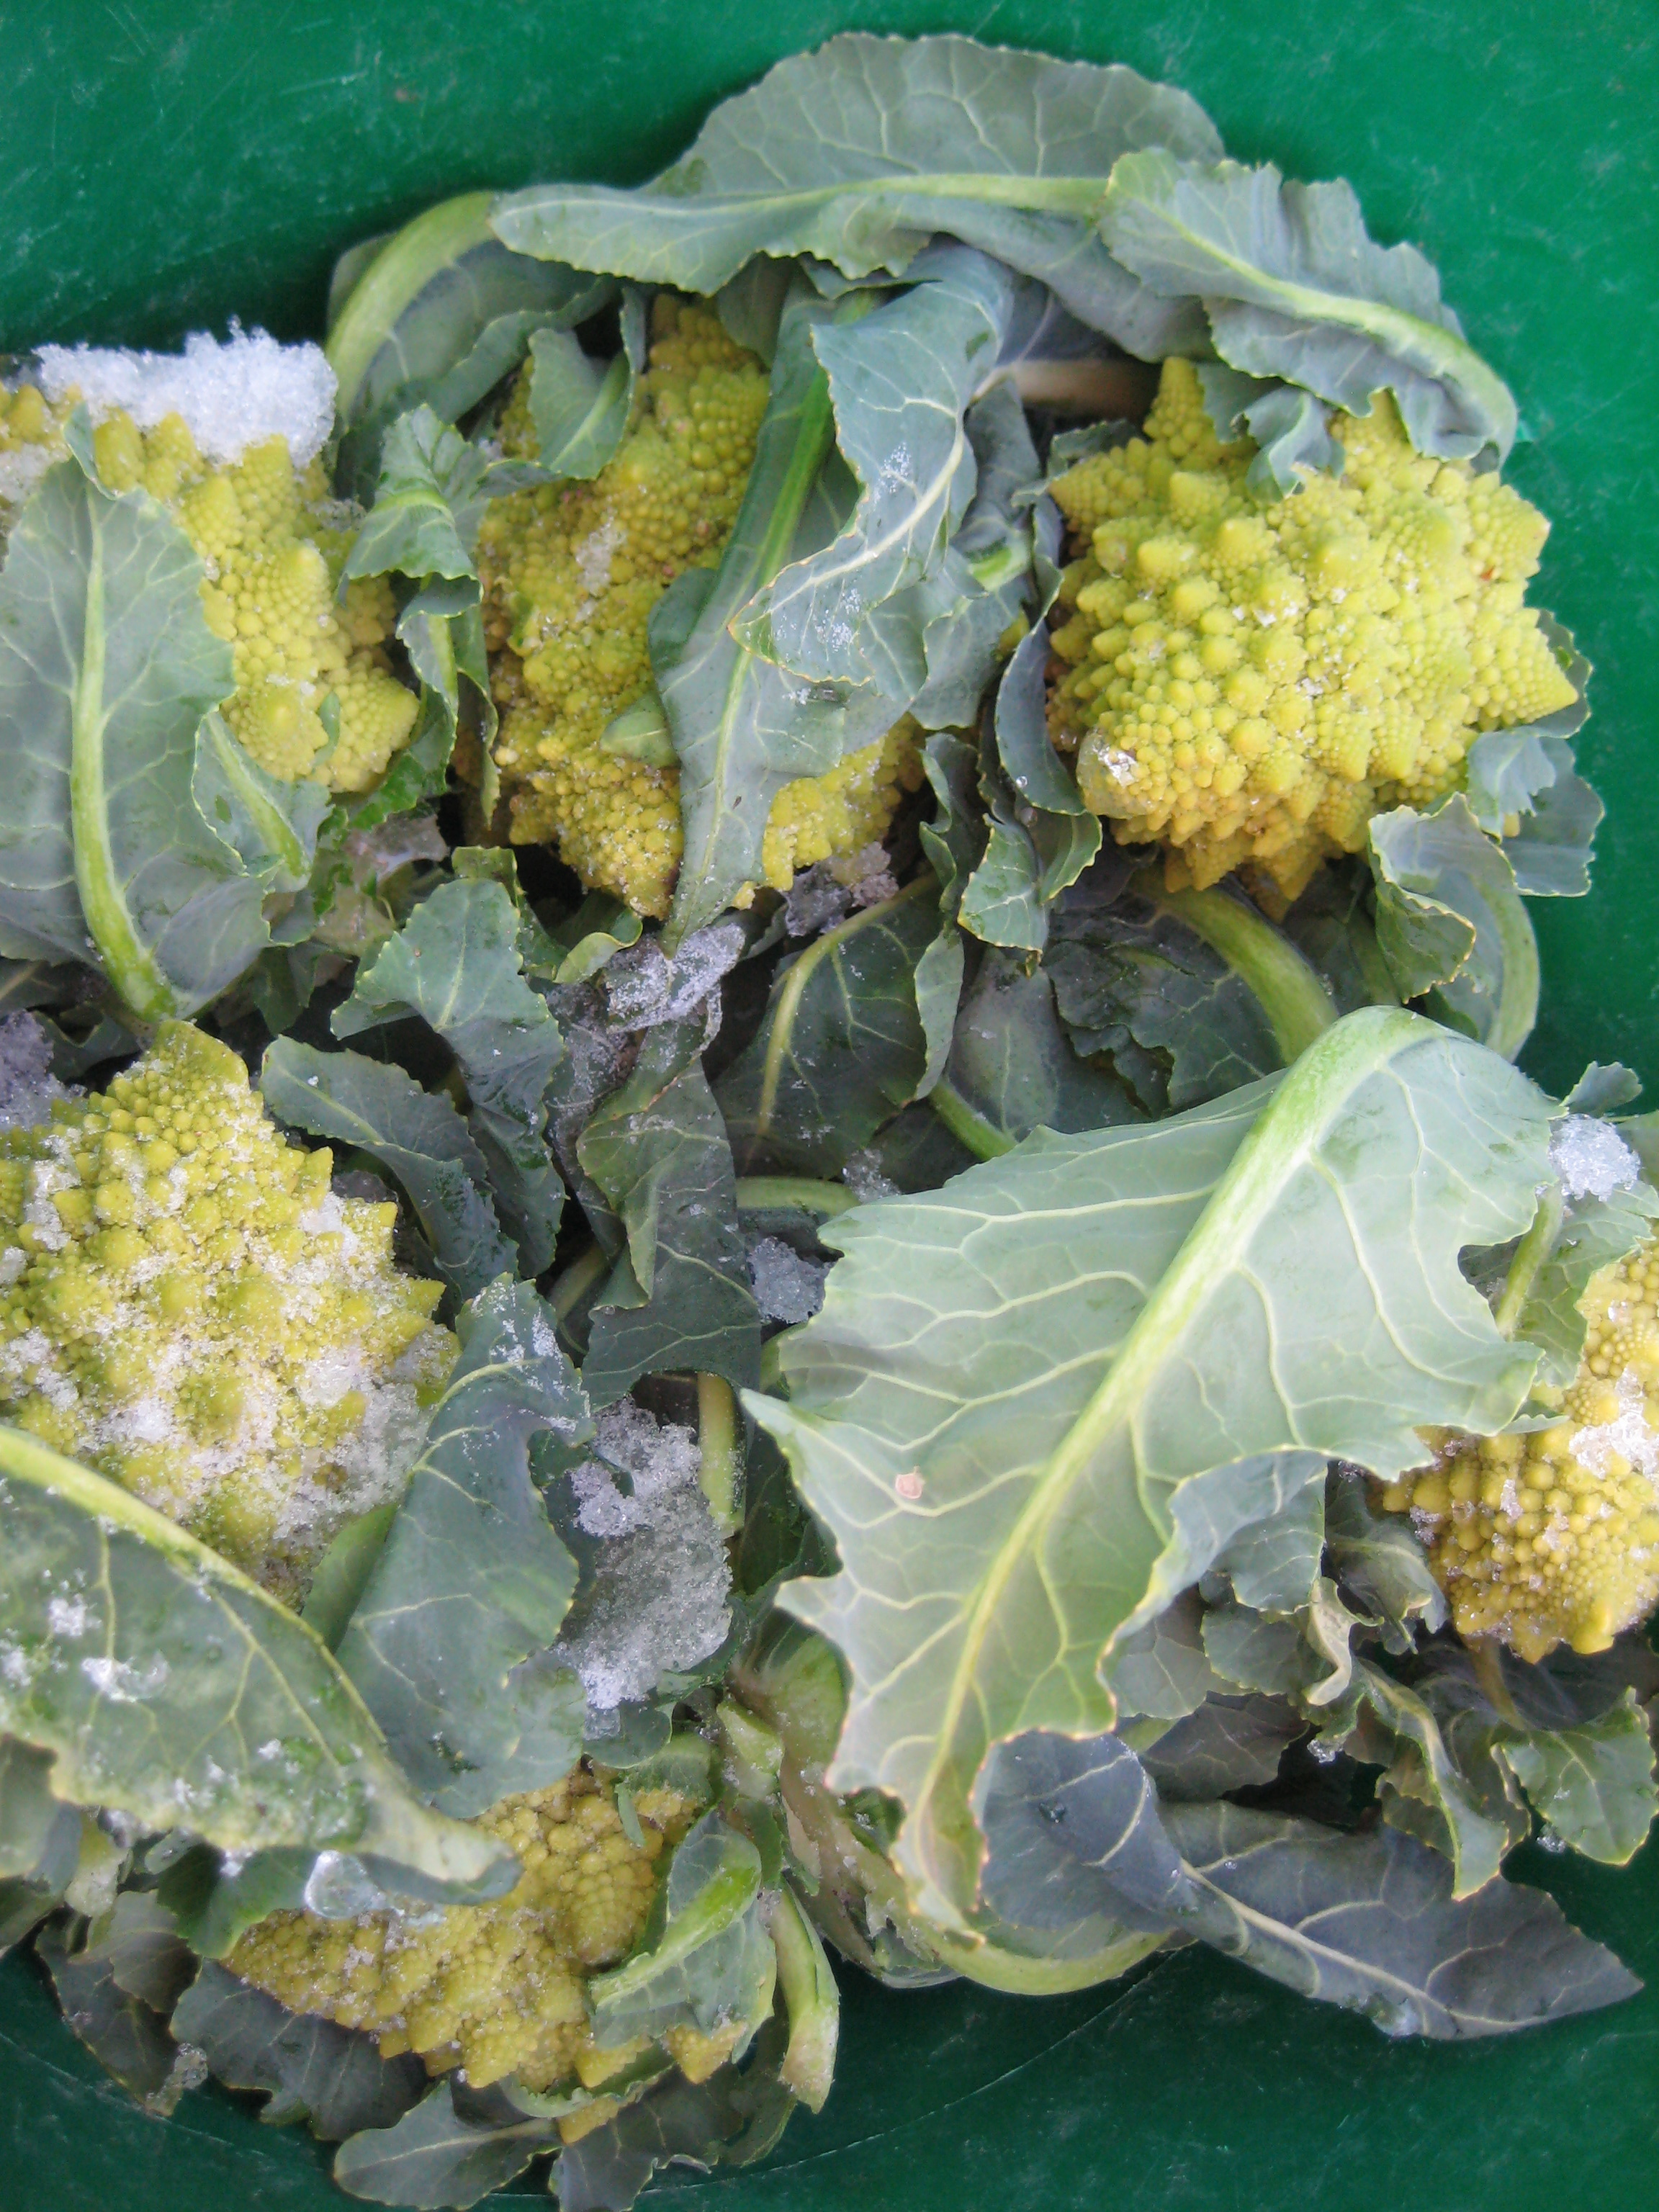
Volunteer Kick Off Meeting
Background
Survey summary and group feedback
Revitalization Goals
Farmers Market Committees and Functions
Break out and brainstorming
Next Steps and meetings

Slide 3
Background
The Hopkinton Farmers Market
was established in 2005 by Weston Nurseries.
Thru 8 seasons the market has operated as
an independent entity with one market
manager responsible for operation.
A wide variety of vendors have been interested in participating
each year but due to the consistently low attendance of
shoppers the market has been unable to sustain attending
farmers and vendors from season to season. Fewer and
inconsistent vendor participation has caused a decline in
attendance.

Slide 4
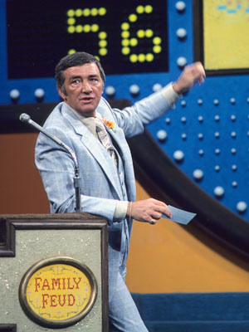
Survey to understand residents’ views 170 responded
66% attend farmers markets weekly or monthly but only 42% of those attend the Hopkinton market
Why more people don’t attend Hopkinton’s market?
Limited vendors & products 63%
Day and time do not suit residents’ schedules 46%
If the market moved to a new location where should it be?
No change 36%
Town Common 51%
Other 13%

Slide 5
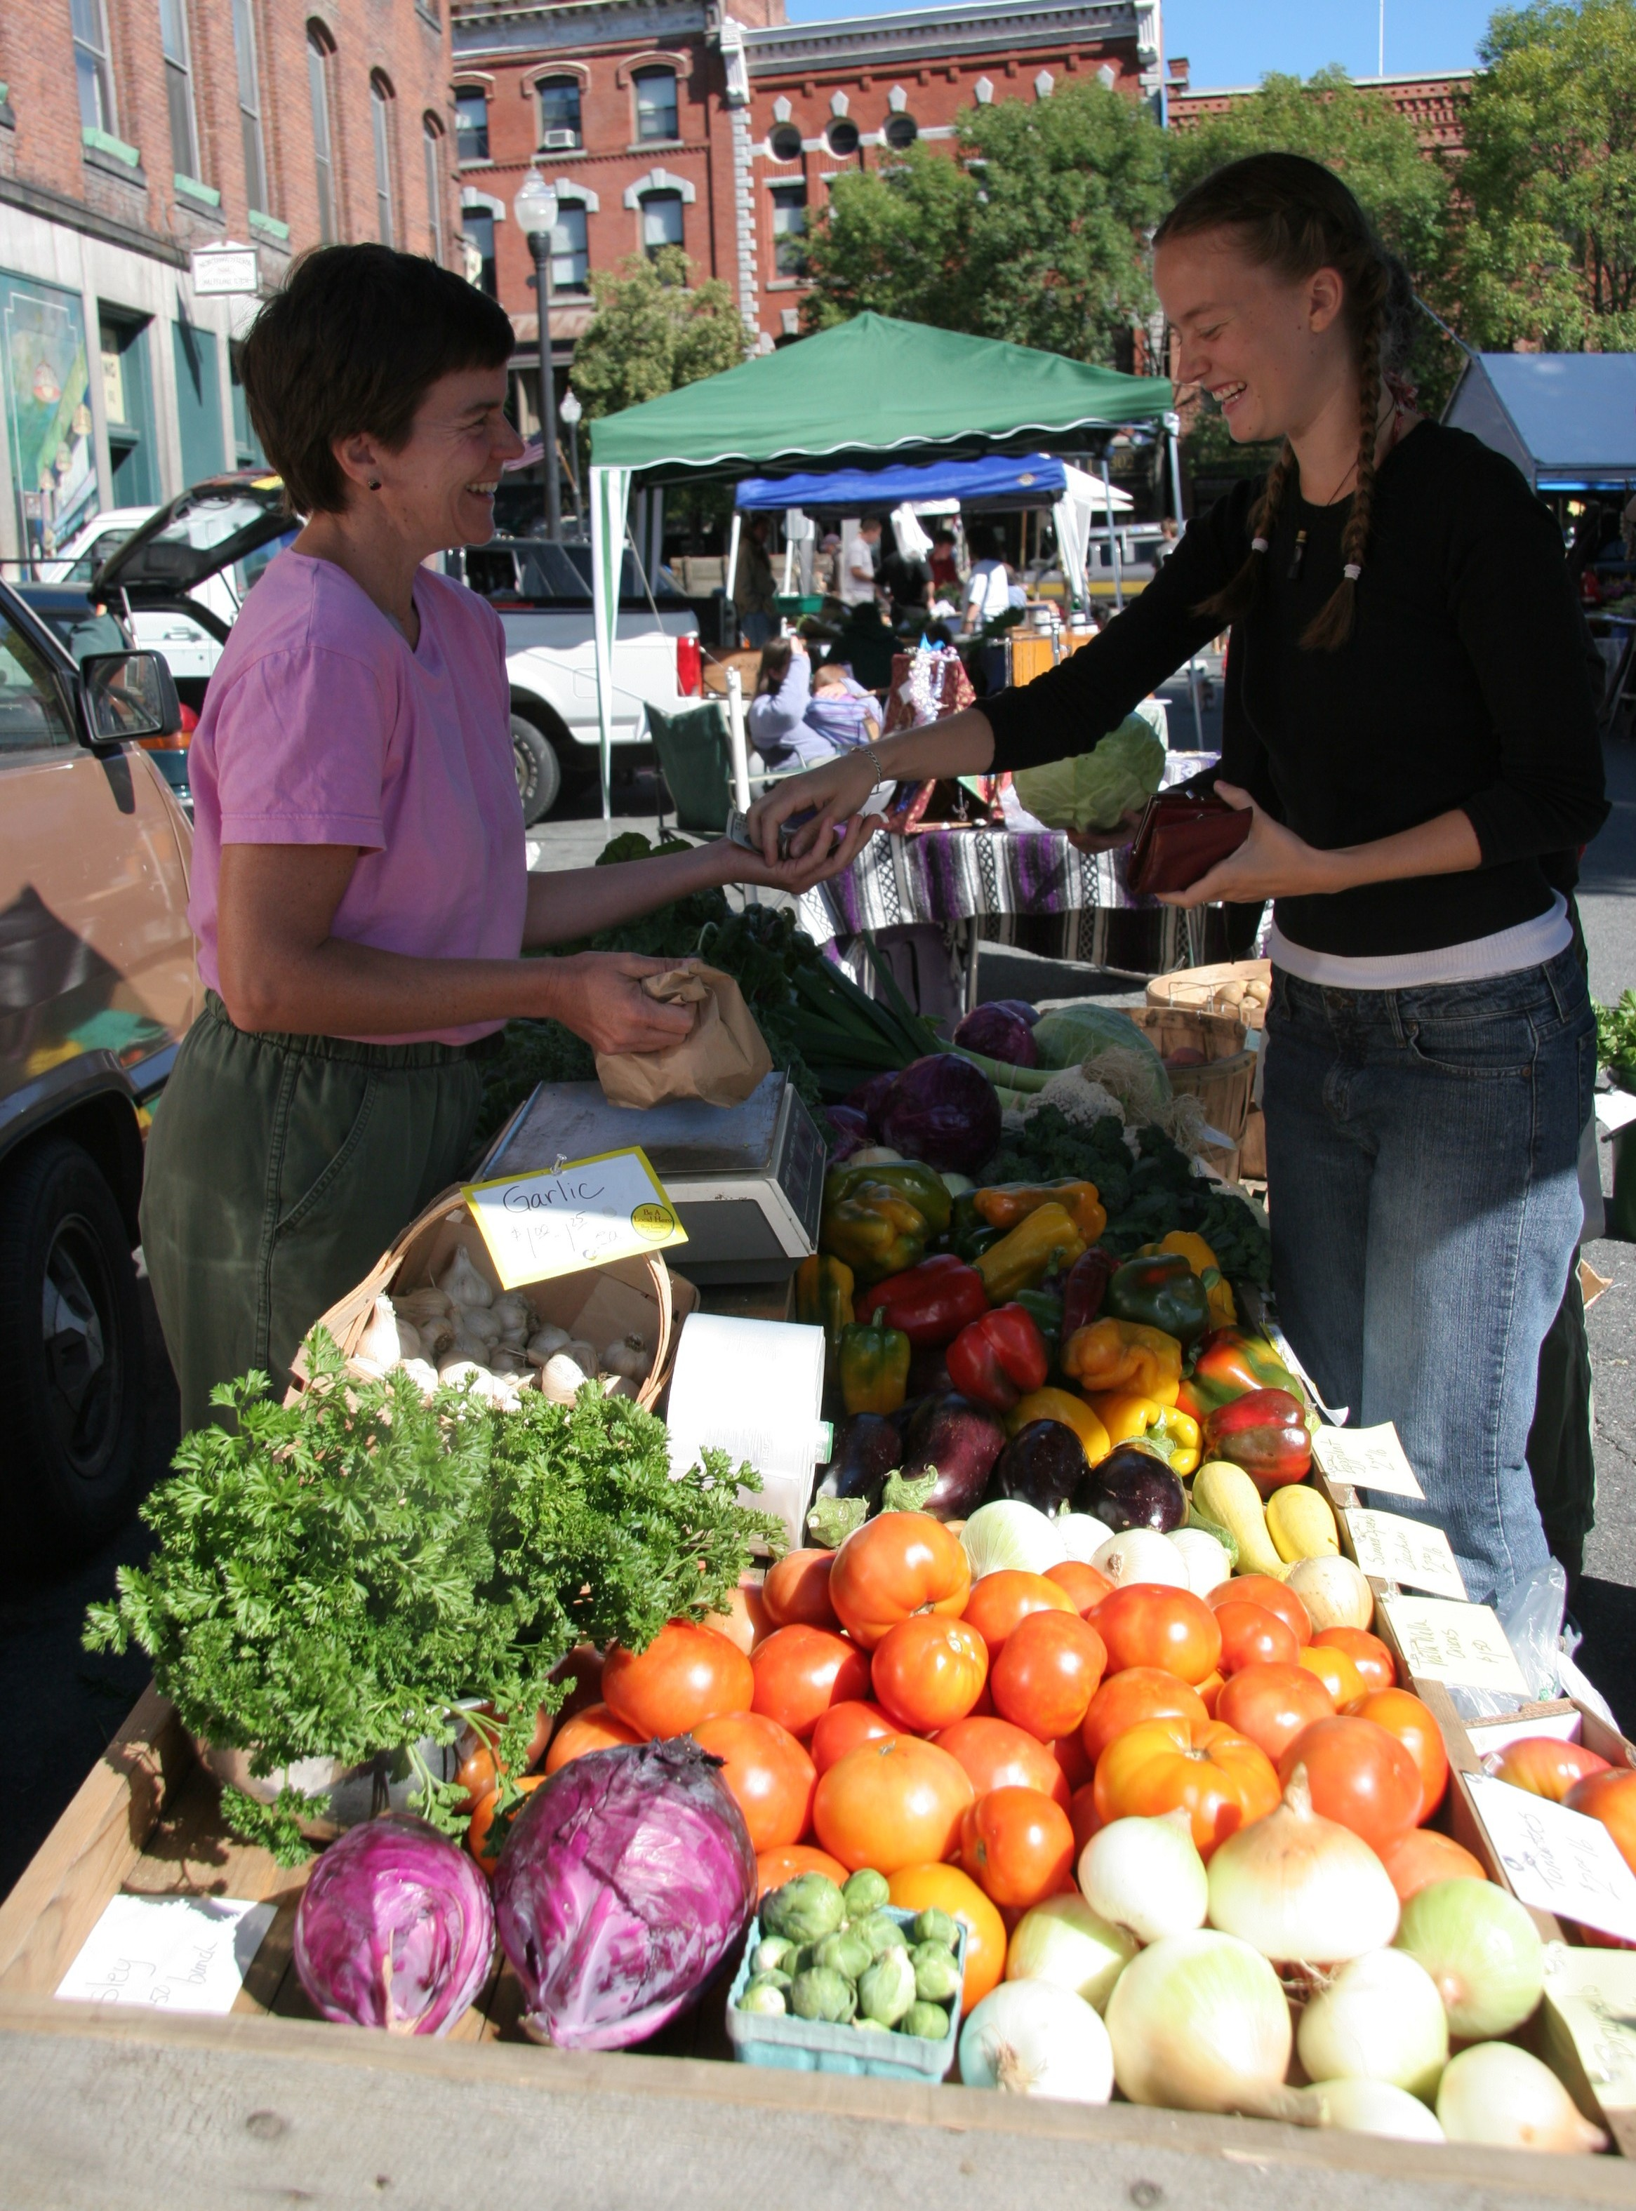
The Community Wants to Buy:
Vegetables and fruit 98%
Bread 66%
Cheese 57%
Honey 48%
Eggs 46%
Pastries, Cookies, Brownies 45%
Pickles and Jams 39%
Fish 34%
Crafts 27%
Wine 26%
Ice Cream 25%
Beef, Pork and Poultry 24%
Jewelry 21%
Pottery 18%
Other: Flowers, Artwork and Ready to eat food

Slide 6
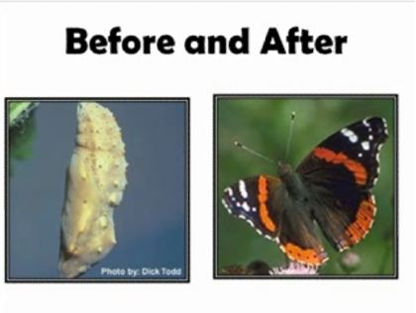
Revitalization Goals
To enhance the availability of fresh, healthy, local food to the residents of Hopkinton
To provide a new home for the market that is a welcoming community gathering place, that is more convenient for town residents. A more prominent location will also bring more attention to downtown businesses
To provide opportunities for local farmers, food producers and artisans to connect with the public and sell their products directly to the consumer
To establish a volunteer organization to organize and operate the market, bringing together residents that are enthusiastic about quality food and growing their community
Transition the legal entity to a non-profit organization that will benefit Hopkinton

Slide 7
Farmers Market Committees
Steering
Food and Farmer Vendor Selection
Artisan and Guest Vendor Selection
Marketing
Fundraising
Logistics
Events
Childrens’ Activity
Administration

Slide 8
Steering Committee: goals, guidance, initiate activities to organize, operate and promote the market
Market Managers (3) : attend training and workshop, available on all market days to manage market,
Treasurer : maintain finances, tax returns, assist with legal entity application
Secretary : take minutes for steering committee, correspondence, collaboration between committees
Hopkinton Town Committee Representative (2)
Downtown Revitalization Committee representative
Agriculture Committee representative
Chamber of Commerce representative
Vendors (3)

Slide 9
Vendor Selection Committees: Identify and recruit appropriate mix of vendors, insure self and locally produced within 35-50 miles
Farmers and Food Vendors 20-23
3 Volunteers
Artisan and Guest Vendors 3-4
1 Volunteer
Vegetables and Fruit 4-5 vendors
Bread 2
Cheese 2
Honey 1
Eggs 2
Pastries, Cookies Brownies 2
Fish 1
Wine 1
Ice Cream 1
Meat 1
Pasta 1
Prepared Food 1-2
Flowers 1
Crafts, Jewelry, Pottery 2-3
Art 1
Non-profit or Community Organization or small local business 1 per week
Girl Scouts/Boy Scouts
PJB
Friends of the Library
HPTA
HCam
YMCA
Friends of the Library

Slide 10
Marketing Committee
8-10 volunteers
Logo and website creation
Marketing plan and implementation
Social media
Advertising
Vendor promotion
Promotional collateral and signs
Market day promotional programs
Blog and postings to sites
Collaborate with other committees, vendors, community

Slide 11
Fundraising Committee
2-4 Volunteers
Formulate Fundraising program for market
Major Sponsors
Seed Sponsors
Grant applications
Collaborate with other committees
Outreach to community organizations and businesses

Slide 12
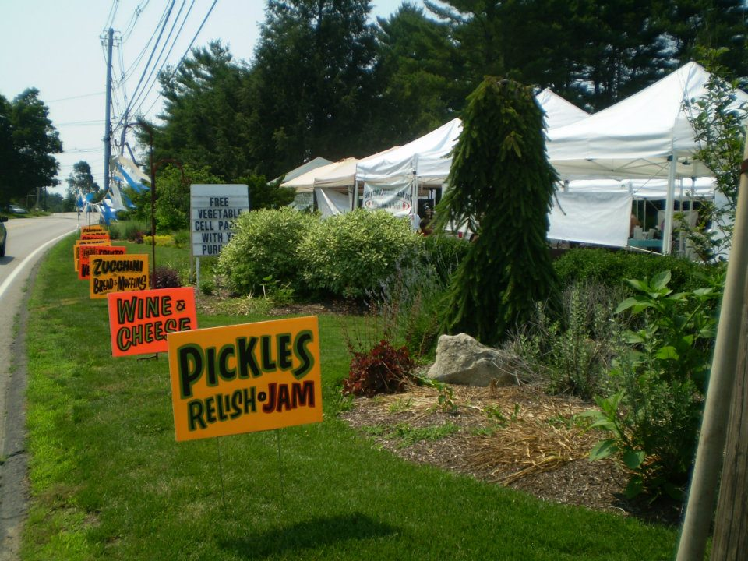
Logistics Committee
4-6 volunteers
Maps out locations for vendor tents
Plans for parking of vendor trucks
Electricity needs
Coordinates market day volunteers: set up and break down of vendors
Acquires pop up tents for market and coordinates storage location : 4
Market welcome tent
Non-profit/local org tent
Children’s activity tent
Music tent
Manages needed hand washing station
Liaison with Parks and Recreation Committee
Coordinates with vendor committees and market managers
Coordinate high school volunteers
Responsible for volunteer schedule and sign in sheets
Portable Toilets

Slide 13
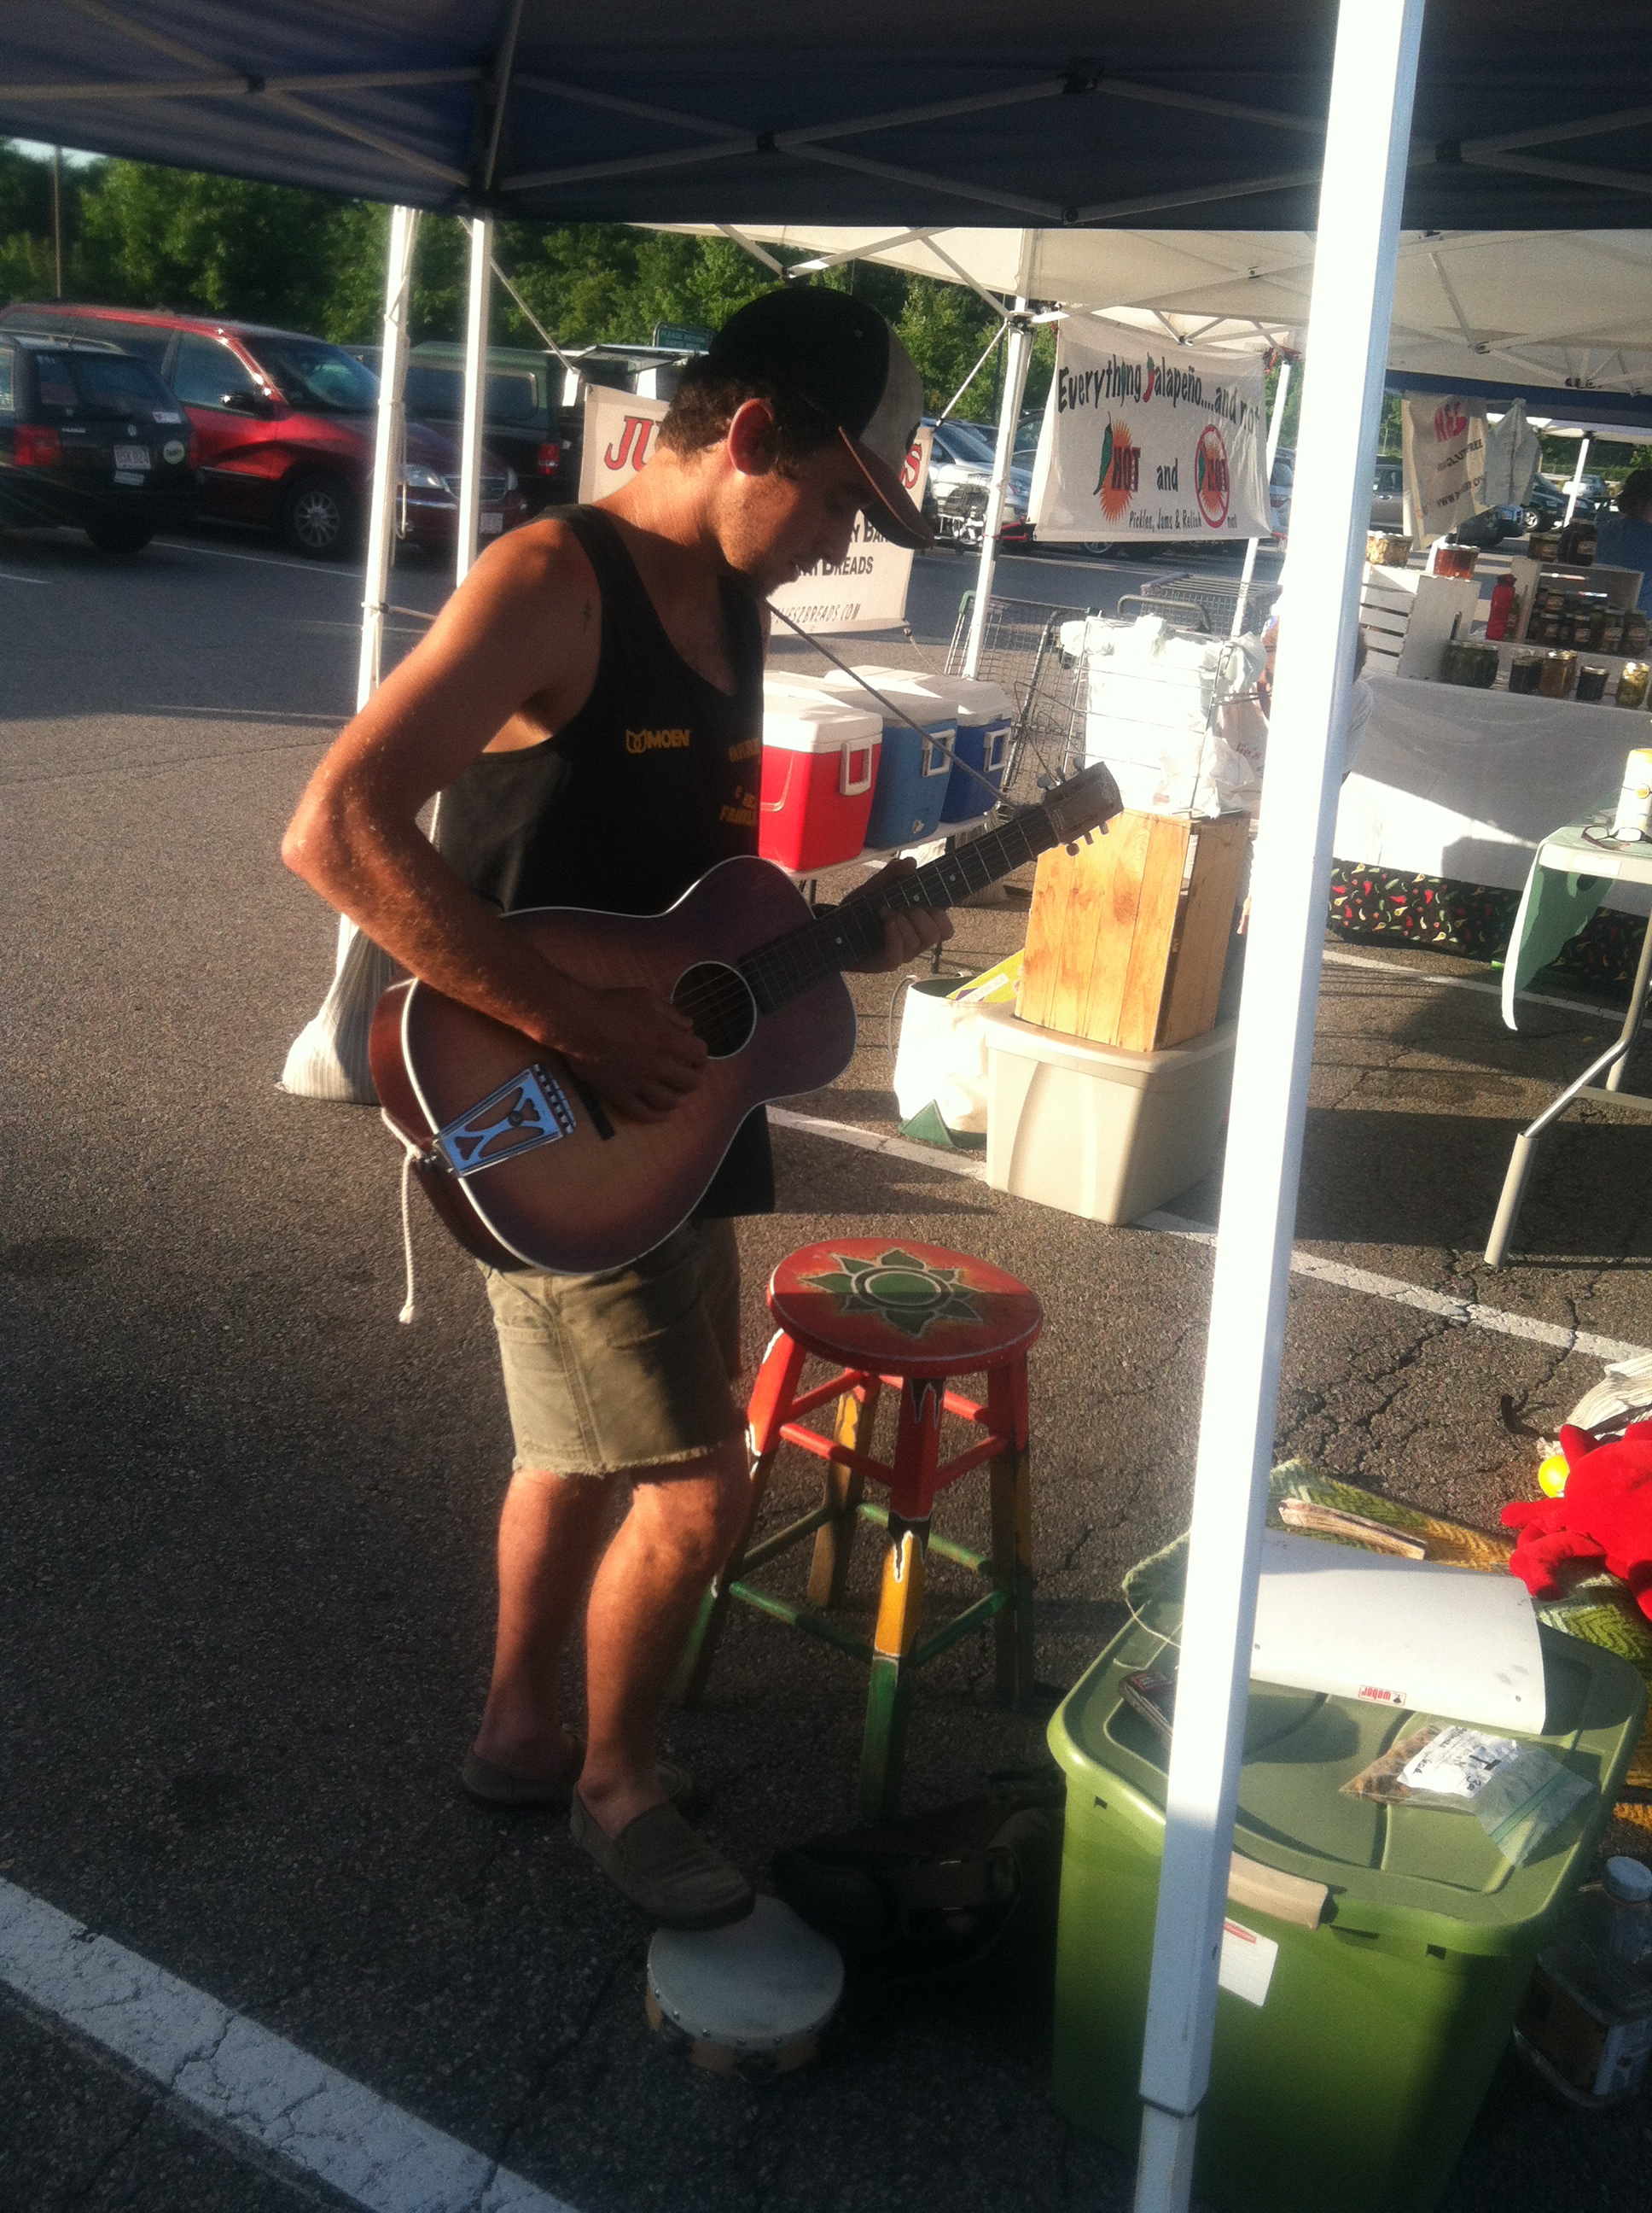
Events Committee weekly on market days
Music entertainment
Special market day promotions
Hula hoop day
Heirloom tomato tasting day
Coordinate with Marketing and Logistics
Partnering with community events: Sunday concerts in the park
Resident Appreciation on the common

Slide 14
Children’s Activity Committee weekly on market days
Special children’s tent
Food, health, nature derived activities during market days for ages children
Scavenger hunts
Make bird feeders
Vegetable ink pads
Pumpkin painting
Coordinate with marketing,
events and logistics

Slide 15
Administration Committee
2 volunteers
Help prepare documentation
for rules and bylaws.
SNAP Application and procedures for market
Coordinate with all committees
Insurance coverage for market, procure copies from vendors
Liaison between food processors and Health inspector/permits
Applications for Mass Fed of Farmers Market and Farmers Market Coalition

Slide 16
Volunteer for Committees
Sign up where you have interest or skill set
Assign a secretary to each committee for notes and action item documentation
Assign a leader for the committee
Set up plan and schedule individual meetings and job assignments

Slide 17
Market Priorities
Most growers are ordering seeds and starting seedlings in January and February, finalizing production plans for 2013 season: need to book now
Many vendors are booking their markets for 2013 and will need to schedule now
Market season usually lasts
about 20 weeks from
mid June to mid October

Slide 18
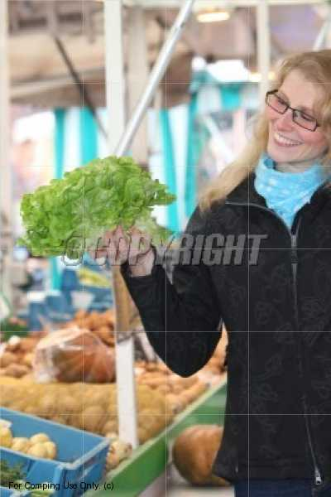
Next Steps
Parks and Recreation Proposal for Approval of Common on January 28
Farmers Market Volunteer Meeting February (tbd)
Committees report on progress
Market Managers sign up for training and workshops January 26 and February 27
Recruit your friends and family: spending time at the market doubles for quality time together

