Slide 1
Organic Gardening Fundamentals
Laura Davis
Long Life Farm
www.LongLifeFarm.com
4/1/16

Slide 2
Themes
Why grow your own organic food?
Practice standards of certified organic operations
It’s not your fault, it’s the soil – fertility
Seed and Seedlings
Seasonal calendar
Tips and resources to help you succeed

Slide 3
Why grow your own organic food?
Potential for better nutrition – depending on soil fertility
Take charge of your food supply - opt out of chemical ag
Most widely used herbicide declared carcinogen by WHO
More flavorful food
Teaching kids how food is grown, great family activity
Great exercise, more sunshine, more Vitamin D
Doing your part to improve climate change and the health of your family and neighbors

Slide 4
Tomato Picking

Slide 5
Certified Organic in the backyard
Organic practice standards:
Certified organic seed and planting stock
Safe Seed Pledge – no GMOs used
Soil fertility and crop nutrient management
Compost approved for OG use
Crop rotation - including cover crop
Improve soil organic matter
Manage deficient or excess plant nutrients
Provide erosion control
Must use practices that prevent crop pests, weeds and diseases

Slide 6
Certified Organic in the backyard
Record keeping of all practices –
Audit trail from seed to sale
Allowed and prohibited substances, methods and ingredients in organic production and handling
Use Organic Materials Review Institute (OMRI) approved products or look up on website www.omri.org
Few synthetics are approved, no treated lumber
Production practices must maintain or improve the natural resources
3rd party inspector visits annually and verifies practice

Slide 7
Soil Fertility
Fertility needs to be put back and maintained for one to grow food that is nutritious, resists insect and disease pressure.
Conventional growers focus on the plant, organic growers focus on the soil.
Soil Testing creates a baseline and helps you understand what inputs/minerals you need to grow good food
UMass Amherst Soil Testing lab – simple and basic
Logan Labs if you are using Organicalc and “the Intelligent Gardener” by Steve Solomon – mineral balancing for better nutrition
http://loganlabs.com/doc/submissionworksheet.pdf
http://loganlabs.com/doc/Soil-Report-Sample.pdf
https://growabundant.com/organicalc-logan-labs/

Slide 8
The Ideal Soil – Balancing Nutrients
Calcium 68%
Magnesium 12%
Potassium 4%
Sodium 2%
Other bases (Copper, Zinc, Manganese, Boron, Cobalt, Selenium, Iron)
Hydrogen 10%
Total 100% a soil such as this will self adjust to 6.5 pH

Slide 9
Soil Fertility
Compost C:N ration 25:1 to 30:1
Compost approved for organic use - Vermont Compost, Coast of Maine
http://klickitatcounty.org/SolidWaste/fileshtml/organics/compostcalc.htm
Green manure (cover crop) oats, peas & vetch winter kills
Natural Mulch: hay and straw around plants; cardboard, clover, weed guard
Nutrients from all these sources become available to plants through the biological and chemical actions

Slide 10
Soil Food Web
Soil Food Web, Inc: Dr. Elaine Ingham www.soilfoodweb.com

Slide 11
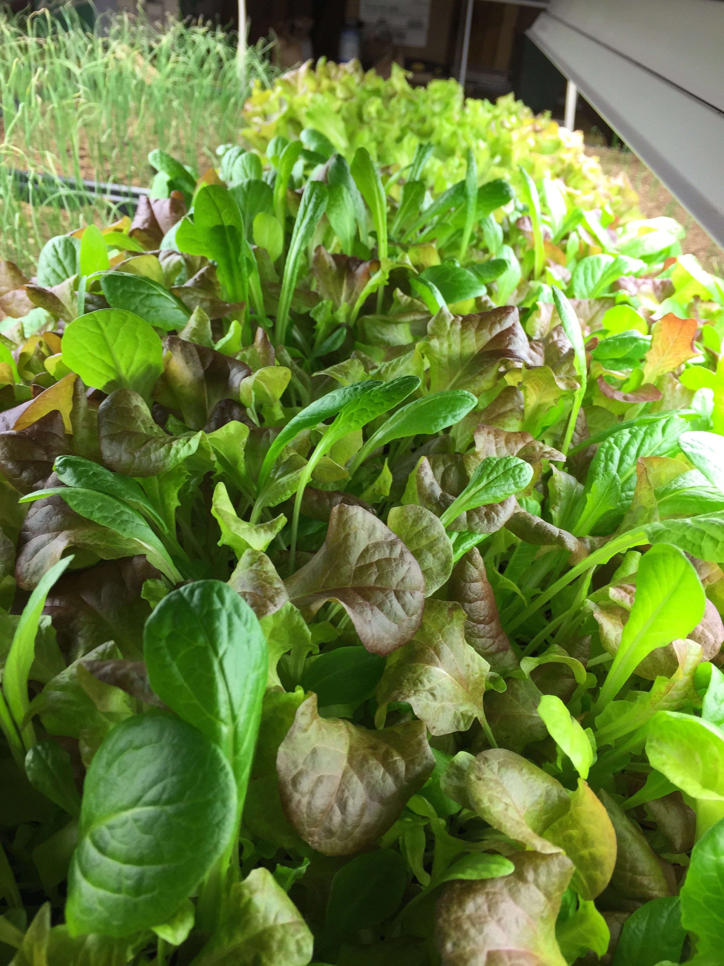
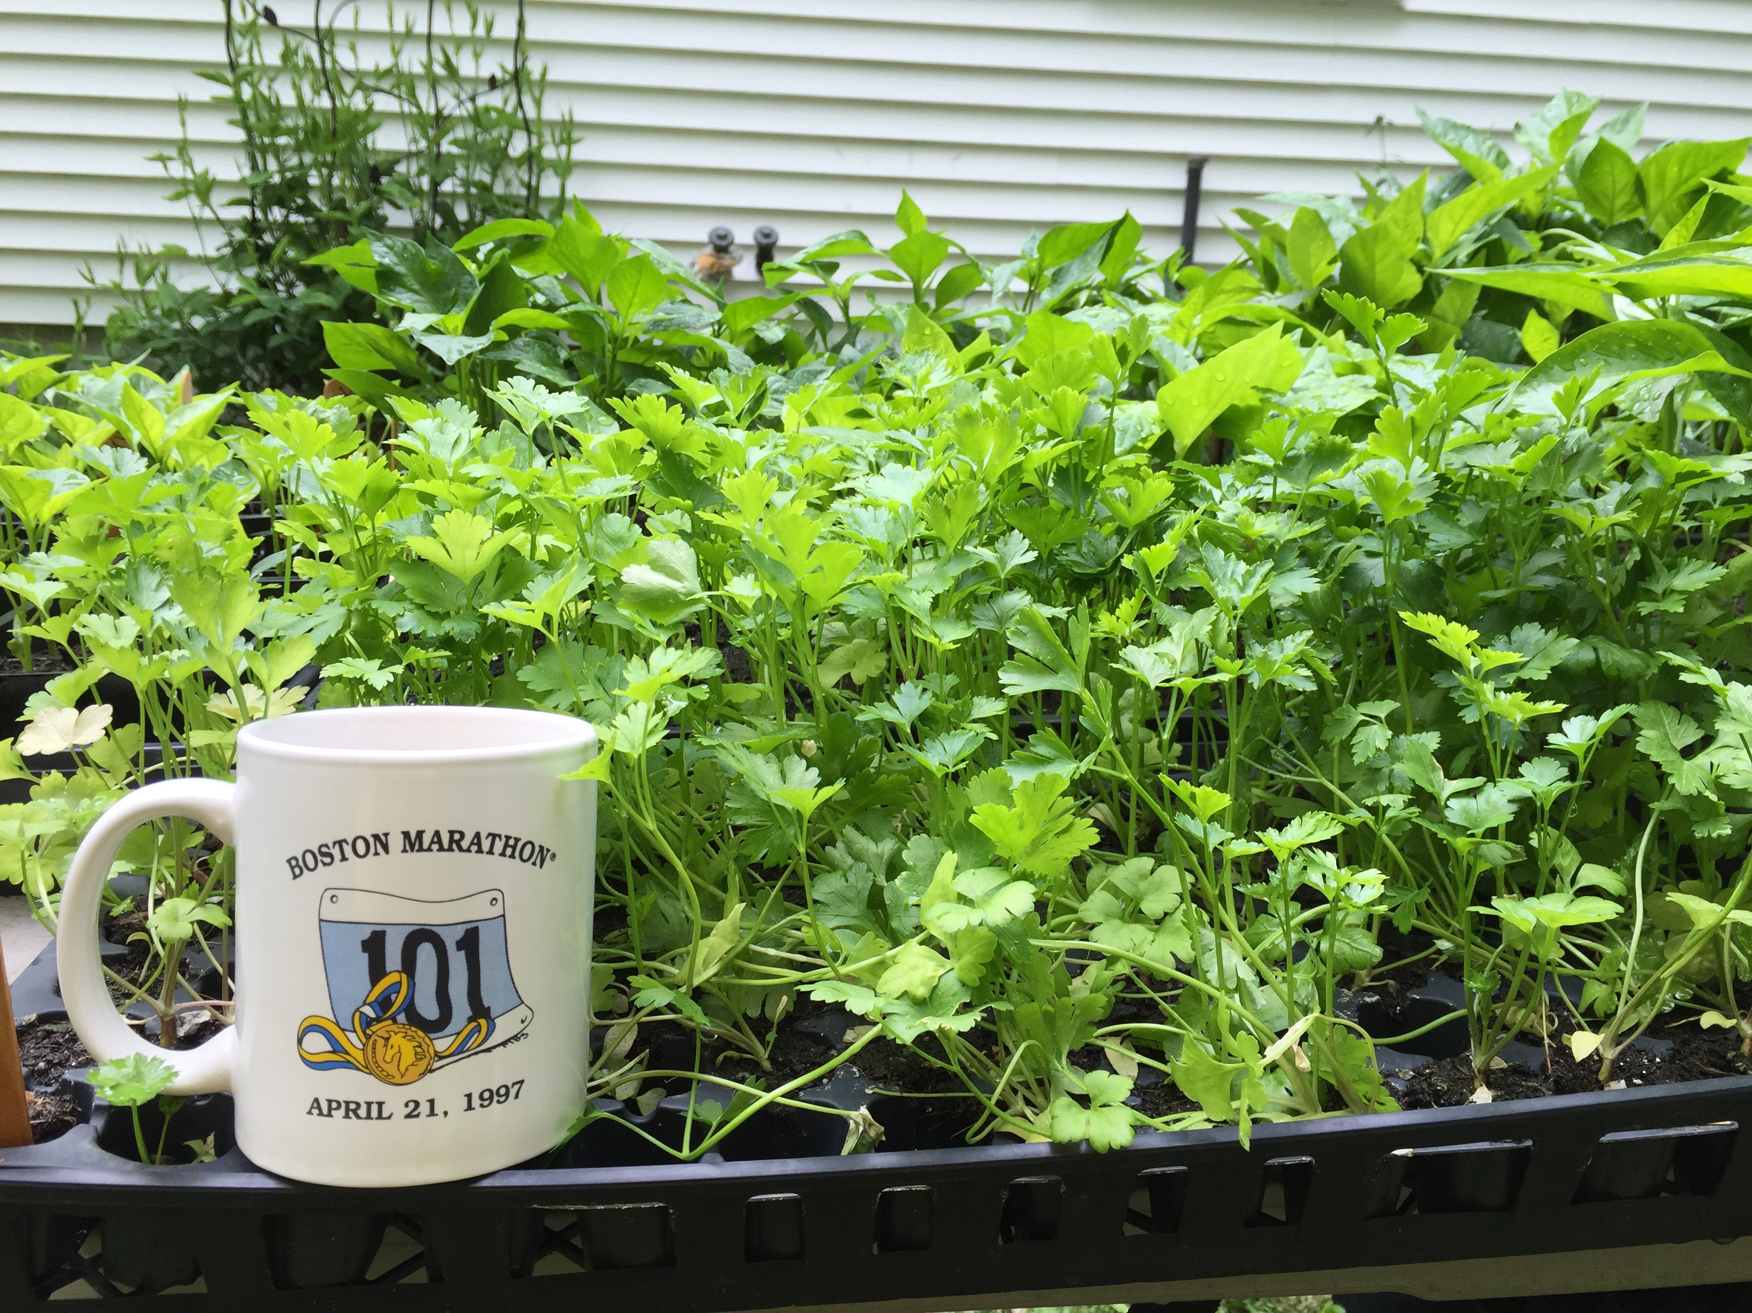
Organic Seed
Starting seedlings at home – certified organic seed from High Mowing Seeds in Vermont, no ship charge http://www.highmowingseeds.com/

Slide 12
Seedlings
Vermont Compost Fort Vee potting soil has all the nutrients plants need for 8-10 weeks
Peppers, Eggplants and Tomatoes 75-85 F heat pad with lid, others don’t need heat, room temp 68-70 F
Need light to germinate: lettuce, celery, rosemary, celeriac
Dome lid maintains moisture, remove immediately after germination
Buying organic seedlings – Natick Community Organic Farm pre-order by 4/29, pick up on 5/5
http://www.natickfarm.org/PDFs/SeedlingOrder2016.pdf

Slide 13
Growing calendar
February – cold tolerant crops seed inside: kale, alliums, cabbage, chard, beets, lettuce, parsley
March – above goes out to unheated hoop house
April spread amendments needed before planting, direct sow snap peas, fava beans, lettuce mix
April – plant cold tolerant crops out into field with hoops and row cover; potatoes
March/April warm weather crops seed inside: toms, peppers, eggplants, melon, cucumber, squash
May/June plant out into field, mulch with hay, straw, weed guard
Cover crop beds as they are harvested, interseed cold weather crops with seed
Soil Test September, spread lime, manure, cover crop
Harvest cold weather crops through Thanksgiving protect with hoop and row covers
New high tunnel : greens until Christmas?

Slide 14
Inside Shop Lights

Slide 15
Onions & kale move outside in March to unheated hoophouse
Row cover over trays when temps go below 32 F

Slide 16
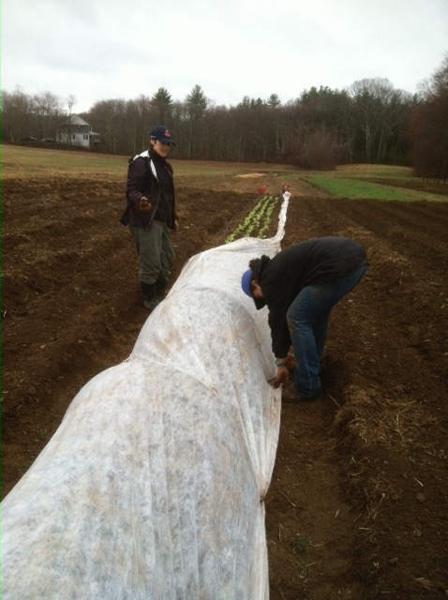
Cold weather crops planted out in April protected by caterpillar
Swiss chard, beets, lettuce, kale, onions, scallions

Slide 17
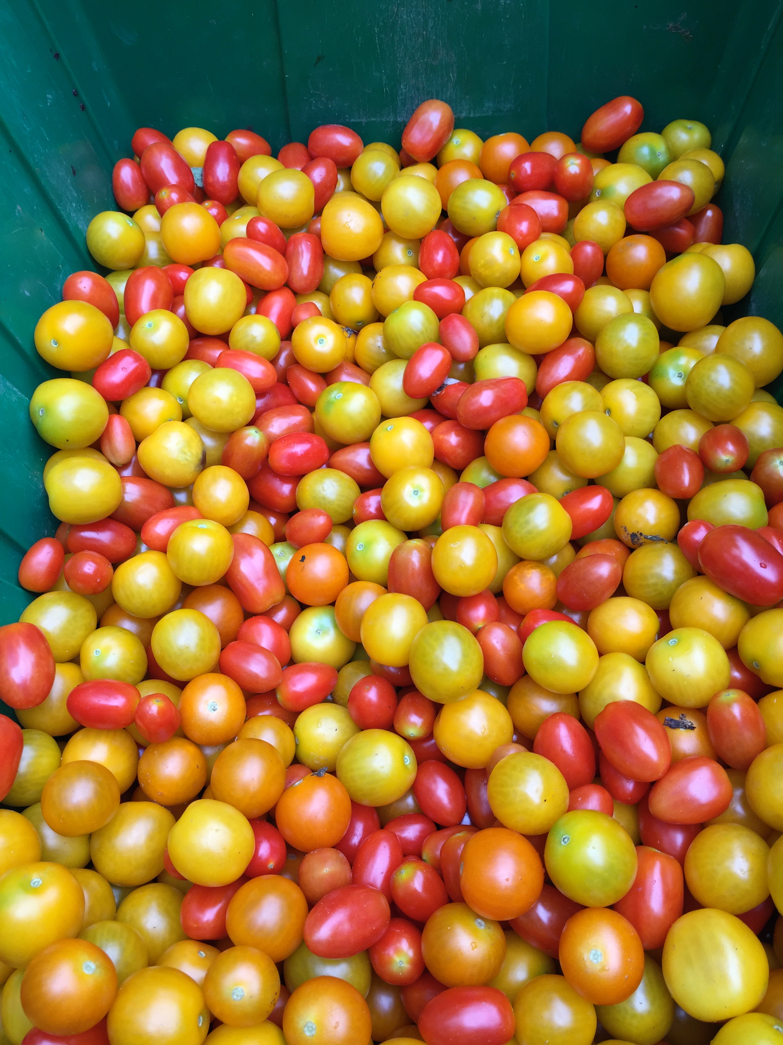
Beans and tomato harvest

Slide 18
Key Ingredients for Enhanced Fertility
Vermont Compost Fort Vee Potting Soil
Biocoat Gold seed coat (humic acid, endomychorrizal fungi) when seeding in trays
http://www.growbetterfood.com/files/8514/0677/0001/Bio-Coat_Gold.pdf
Neptunes Harvest (fish emulsion)/kelp mix 2% with water when planting and every other week as needed, also use this as a foliar spray
Hay or straw mulch, plastic for warmth, keep the ground covered
Nitrogen sources: Neptune’s Harvest, soybean meal, Kreher’s composted chicken manure, alfalfa meal
Minerals and trace elements per soil test

Slide 19
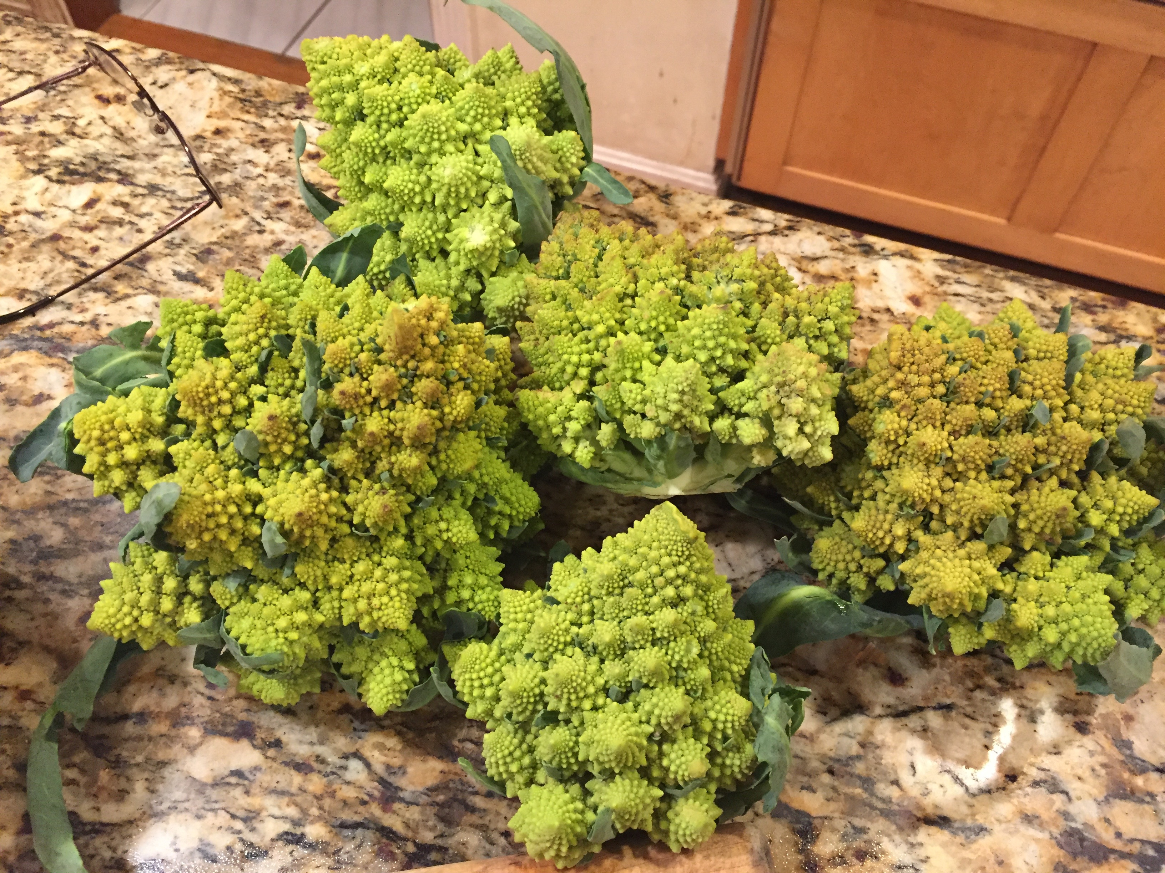
Sweet Potato and Romanesco Cauliflower

Slide 20
OMRI approved Pest Solutions
Cabbage worms, cabbage lopers, tomato hornworm:
Dipel : bacillus thuringiensis : dusk to avoid bees
Fall Aphids: Safersoap
Ground hog, rabbits : Plantskydd sprayed around perimeter of bed
Deer: Electric wire powered by solar box - Deerbusters
Cucumber and flea beetles, potato beetles: Row cover, hand picking

Slide 21
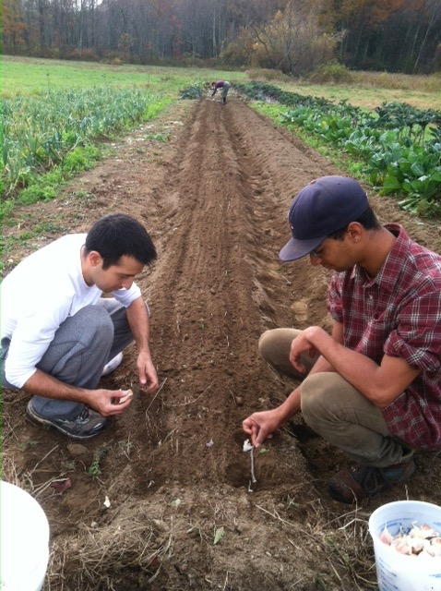
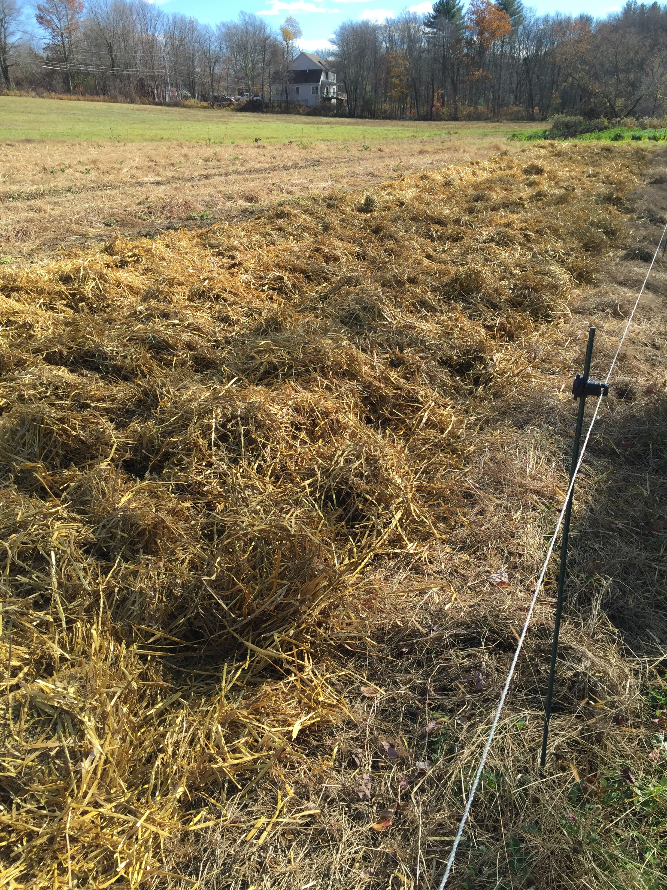
Planting Garlic Fall

Slide 22
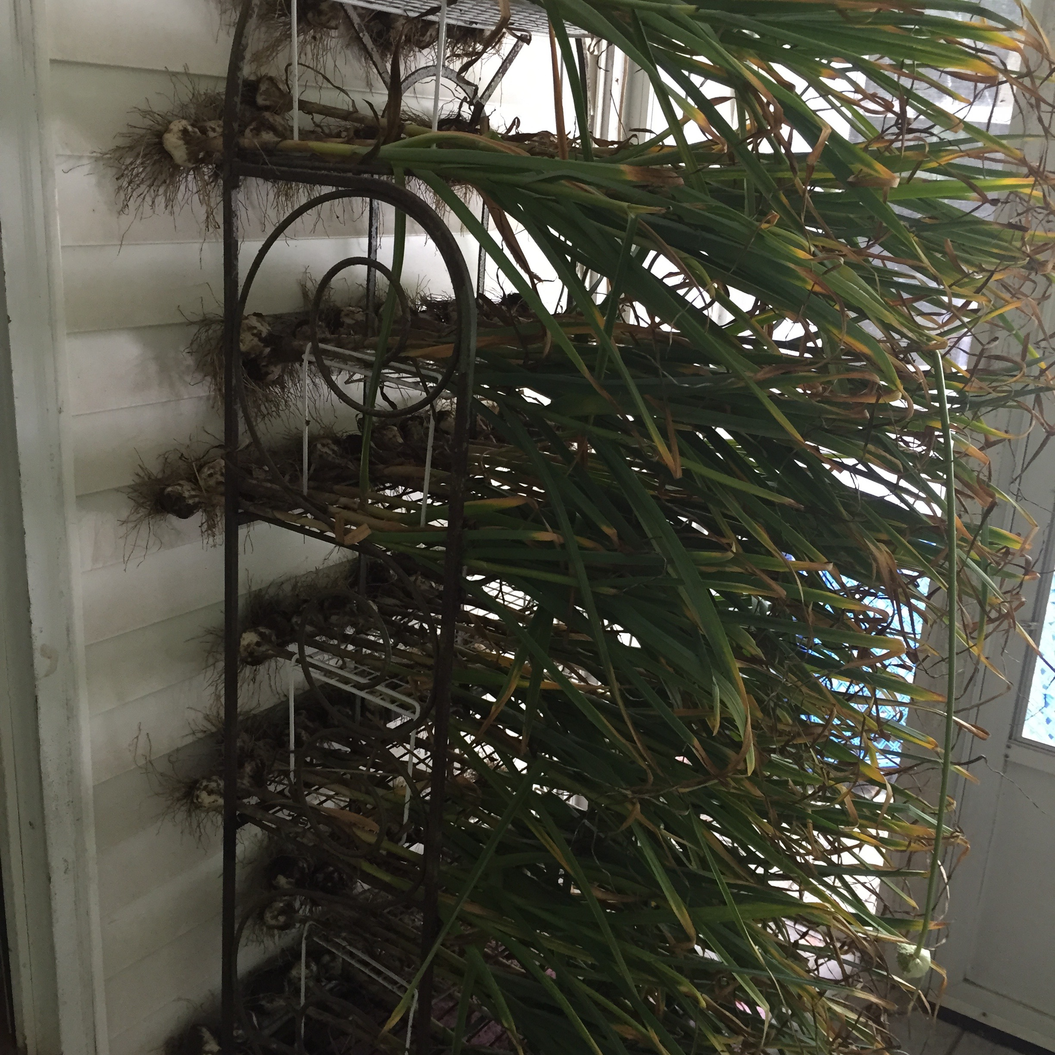
Harvesting Garlic July
Cure garlic for 2-3 weeks

Slide 23
Tying Tomato Plants

Slide 24
Trellis for snap peas and pole beans - Hortonovo

Slide 25
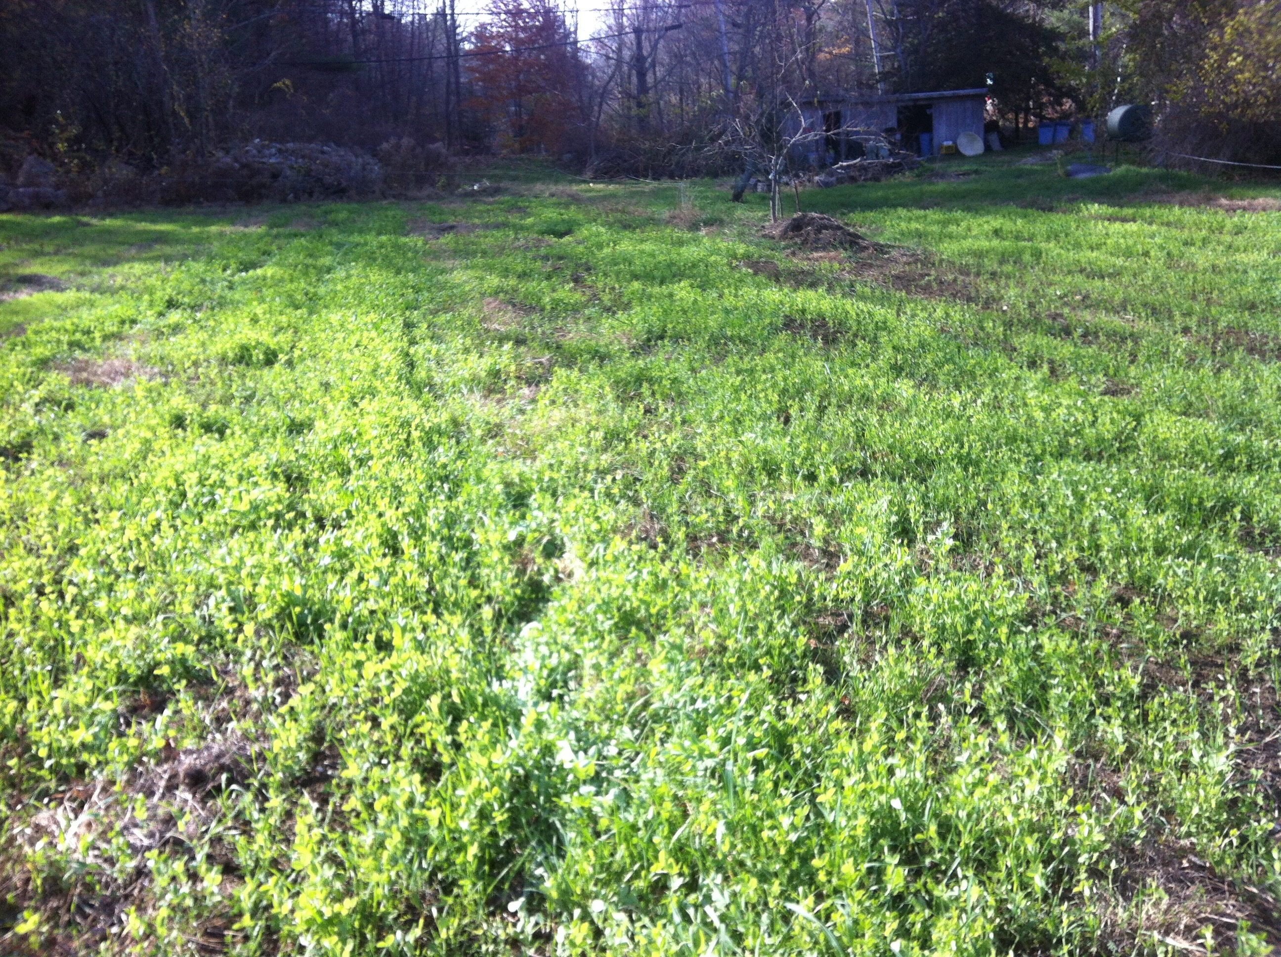
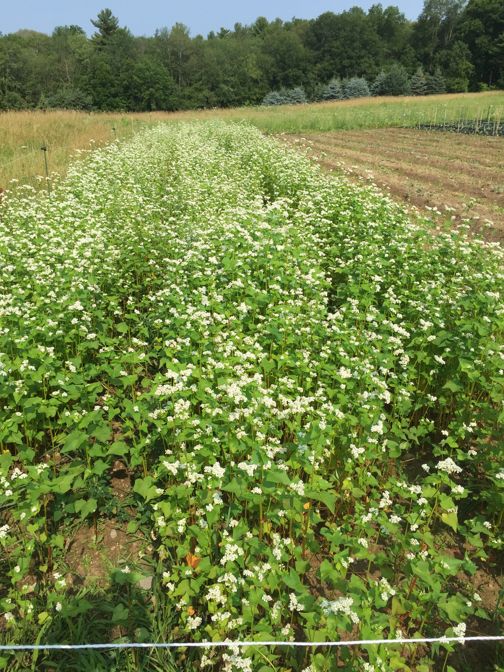
Green Manure – Cover Crops
Oats, peas, vetch and buckwheat

Slide 26
Tending your own patch
When you add compost and build humus in your soil you are helping to pull carbon out of the atmosphere and put it back into the soil
When you grow your own food, you are growing your own nutrition
When you grow organically you are protecting our environment and our natural resources
60% of Hopkinton residents are on well water vulnerable to contamination
Don’t forget about your lawn, certified organic landscapers can be located here. If you are doing your own lawn, please see NOFA tools for organic land care.
http://nofa.organiclandcare.net/

Slide 27
Weston Nurseries and Angels Garden Center
Neptune’s Harvest Fish & Seaweed
Neptune’s Harvest Seaweed
Coast of Maine soil and compost: Angels & Weston
Botanical Interests seeds – some are OG look for the USDA OG label
High Mowing Organic Seeds: Angels
Just Natural Raised Bed Soil Mix
Espoma – Full line of fertilizers
Other Organic fertilizers: Angels
Garden Gypsum

Slide 28
Resources
www.Nofamass.org/events – organic workshops for gardeners
NOFA/Mass bulk order open Jan 1-30 for order pick up mid March, potato pick up mid April. These are supplies not often found near by and consolidated for better pricing.
www. Rodalewellness.com
http://www.rodalesorganiclife.com/
http://progressivegrowersinc.com/ organic inputs in W. Wareham
Brookdale Fruit Farm, Hollis, NH – row cover, weed mat
https://ag.umass.edu/print/9605 regarding winter moths
Johnny’s for hand tools, bed rake, garden knives

Slide 29
Seed Companies
High Mowing Seed, VT 100% organic, non-gmo verified
www.highmowingseeds.com
Johnny’ Selected Seeds, ME http://www.johnnyseeds.com/
Fedco, ME – www.fedcoseeds.com
Territorial Seeds, OR - http://www.territorialseed.com/
Seed Savers Exchange, IA
Maine Potato Lady, ME
Botanical Interests, CO
Southern Seed Exchange, VA

Slide 30
Thank you!

